Slide 1
RWI Phonics Parent Meeting

Slide 2
Reading changes everything
Teach a child to read and keep that child reading and we will change everything.
And I mean everything.
Jeanette Winterson
A complete literacy programme - systematic and structured.
Meets the demands of the national curriculum, giving your children the best chance of success not only in national tests e.g. Y1 phonic screening test, but it also provides them more opportunities to read fluently, like story tellers, and to develop a greater depth of understanding.
Notes:
Read quote.
This is what we do in our school.
Research shows that children who learn to read early go on to succeed both in school and in life.
Today I will explain how your child will learn to read using the Read Write Inc. Phonics programme.

Slide 3
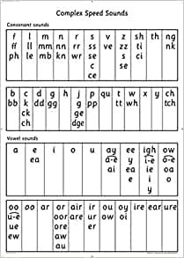
What is phonics?
https://www.youtube.com/watch?v=p_6Jb0-3qz8

Slide 4



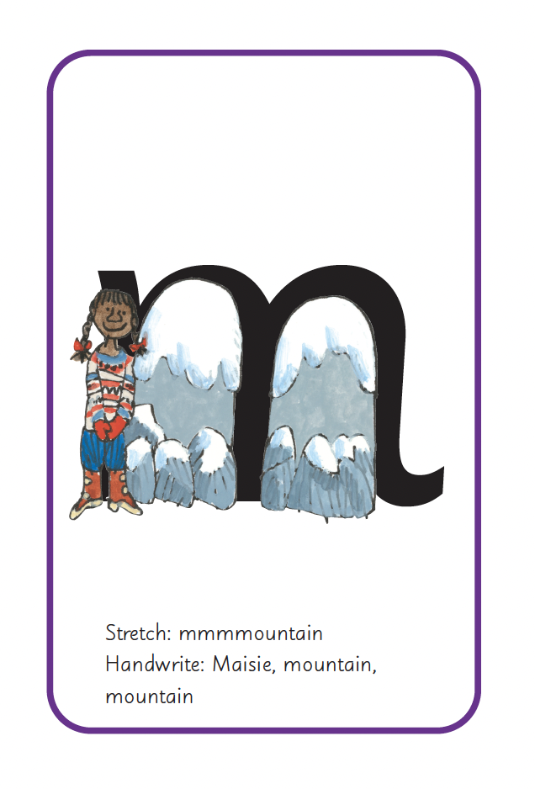


RWI in Foundation Stage
Systematic, structured as we move through the scheme, children learn sounds, read words and then read simple stories.
Whole class teaching of sounds and then group rotation for writing sounds and blending sounds to read words.
Regular assessments enable children to be placed in a group which best matches their needs.
School/home communication if we feel your child may need a little more support to reach the expected point in the scheme through the year.

Slide 5

One-to-one tutoring – ‘keep up, not catch up!’
School/home communication if we feel your child may need a little more support to reach the expected point in the scheme through the year.
Notes:
We want to make sure every child learns to read in our school.
Some children need extra practice when learning to read so we teach these children one-to-one for ten minutes every day – on top of their group lesson.
We make sure they ‘keep up’ from the beginning and don’t need ‘catch up’ later on.

Slide 6
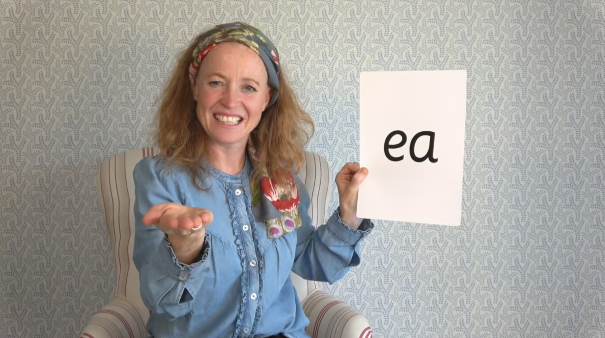
Virtual Classroom films
Notes:
Each week, we will send home film links to lessons that match the sounds and words your child has been learning in school.
There are lessons to support children at every stage of the Read Write Inc. Phonics programme.
Your child uses the Virtual Classroom in school.
Children are familiar with the VC teachers – and interact with them as they would their own teacher.
Watch these films with your child to help them to practise reading the sounds and words until they can read them speedily.
Simply click the link and watch on a tablet or other device.
Let’s have a look at one of these films on the Virtual Classroom. Play a Set 2 or 3 at home film from the virtual classroom.

Slide 7
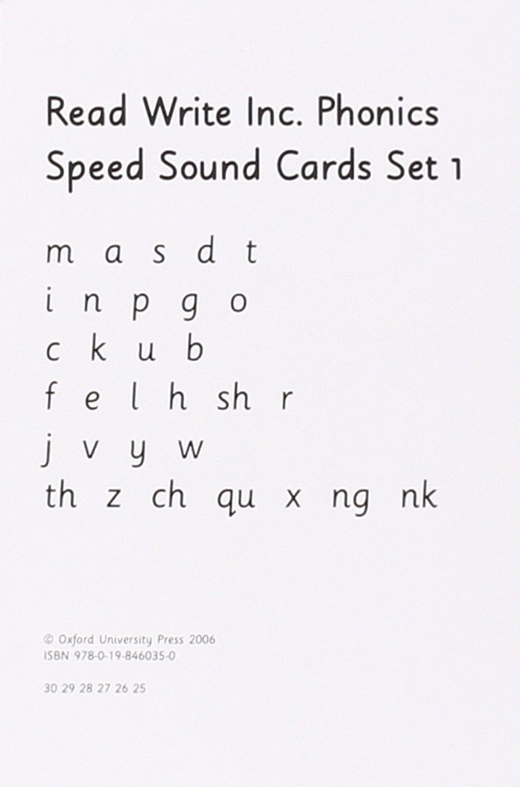

Set 1 sounds
Pure sounds
https://www.youtube.com/watch?v=KUbrJPAt65g
Special Friends
These are sounds that are made of two letters.

Slide 8
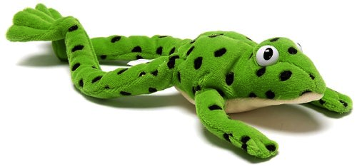
'Oral Fred talk', ‘Fred talk’ and ‘Fred in your head’

Slide 9

Spelling new words
Fred fingers

Slide 10
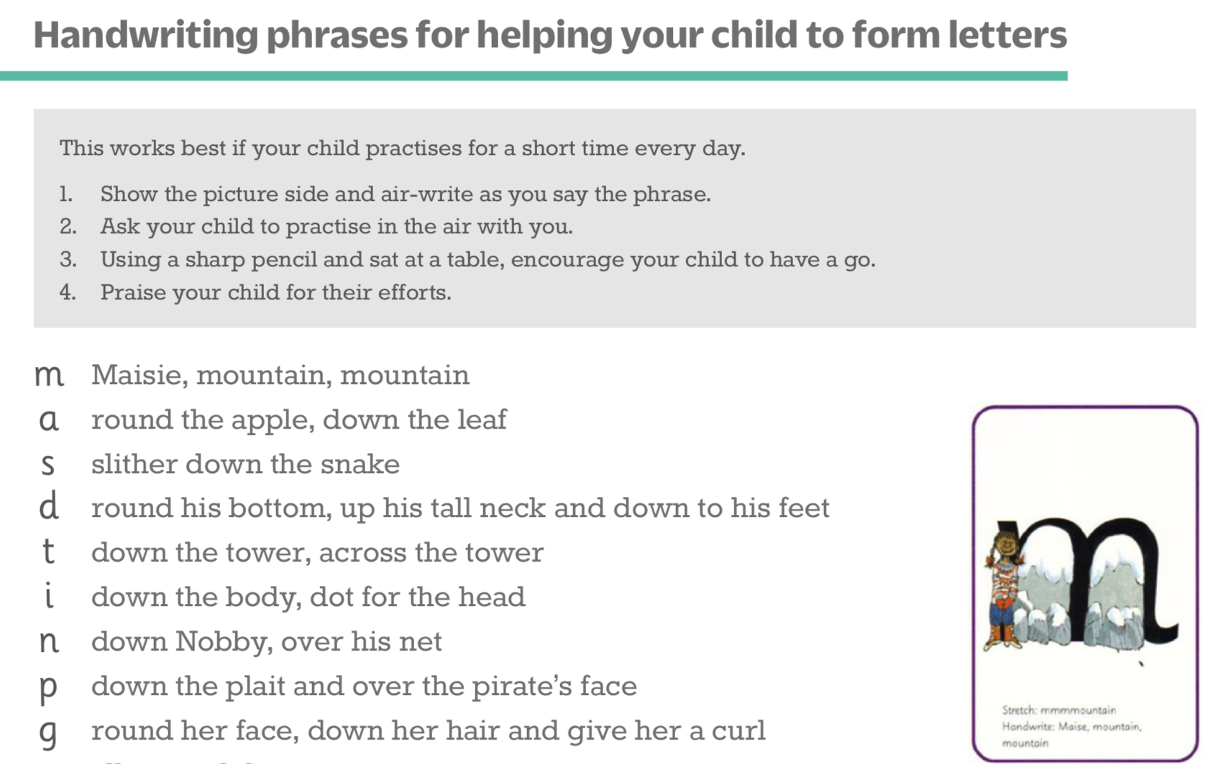
Teaching letter formation
A copy of the phrases will be attached to your child’s reading record.

Slide 11


Reading books
What books are in your child's bookbag and what are their purpose to help your child in their reading journey?
Reading records

Slide 12

Sharing books
One of the most important things you can do as a parent at home is read to your child.

Slide 13
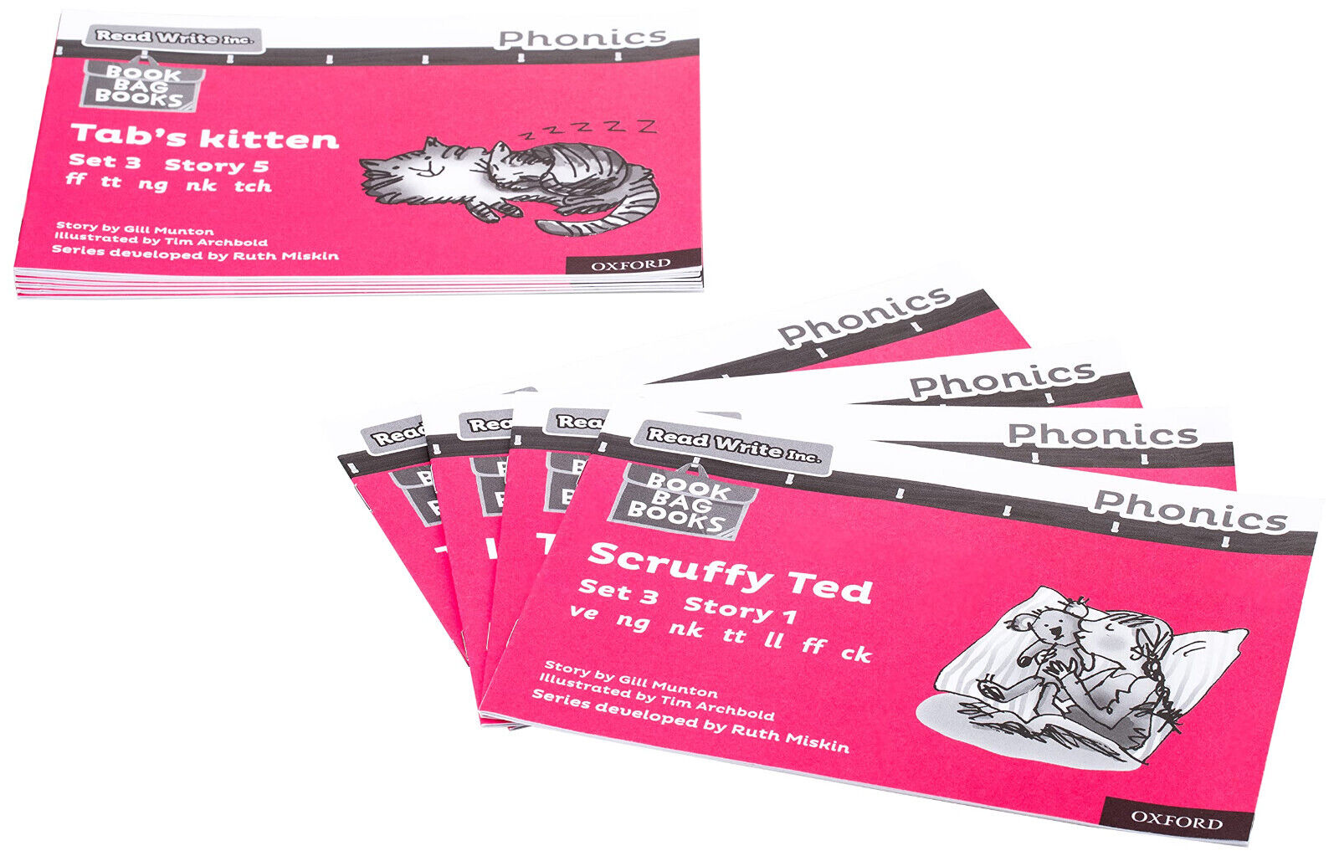
RWI Core Storybook
The core Read Write Inc. Phonics storybooks are the best option for home reading: children read the story three times at school and read it again at home to build their confidence and fluency.
Your child has a Storybook matched to the sounds and words they know – a decodable book – so they should be able to read all the words. Giving your child the feeling of success!
Please avoid saying, “This book is too easy for you!” but instead say “I love how well you can read this book!”
Children can work on prosody/expression and their comprehension skills that are enabled with fluent reading.

Slide 14

Book Bag Books
The first Book Bag Book your child will bring home is a Sound Blending book – these books have single words to read on each page.
Read Write Inc. Phonics Book Bag Books help reinforce classroom learning with reading at home to accelerate reading progress.
They are matched to your child's phonic knowledge.

Slide 15
How to help your child at home…
Listen to your child read their storybook – little and often is best! Daily if possible, please and note in your child’s reading record.
Read stories to your child every day.
Use pure sounds rather than letter names.
RWI pack – to secure set 1 sounds and to help independent blending of words.
RWI website – free parent videos and resources
https://www.ruthmiskin.com/programmes/phonics/

Slide 16
How to help your child at home…
Parent/Carer Responsibility:
We ask that you agree to support your child’s learning and do the following at home:
Listen to your child read their decodable phonics book 5 times per week.
Read them a bedtime story, read for pleasure and share stories as much as you can!
Help your child to count, up to 10, objects accurately saying the correct number for each object.

Slide 17


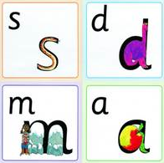

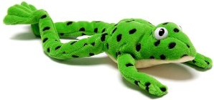
Thank you...
Birthday Book Box
RWI Sound card pack
Magnetic boards
Sharing books – happy reading!

